Slide 1
4483/8995 CAPSTONE PROJECT PRESENTATION
Big Cats Classification
Ahmed Anwar / u3244786
TUTORIAL GROUP – WEEKDAY/TIME: Friday/11:30 (online)

Slide 2
Table of Contents
Introduction / Problem Statement
Dataset Details
EDA (Exploratory Data Analysis) Outcomes
PDA (Predictive Data Analytics) Outcomes
Implementation and Deployment (TkInter/Flask/Streamlit) Plan and Status Update
References/Bibliography

Slide 3
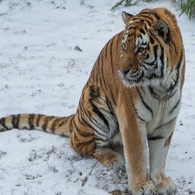
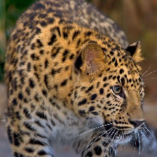
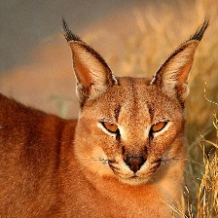
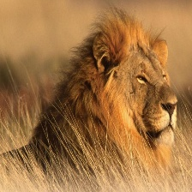
Introduction / Problem Statement
Challenge is to identify different cats in the wild using image classification model
The challenge with this problem is the large variability in cat appearances due to factors such as lighting conditions, camera angles, and natural variations within the cat population.

Slide 4
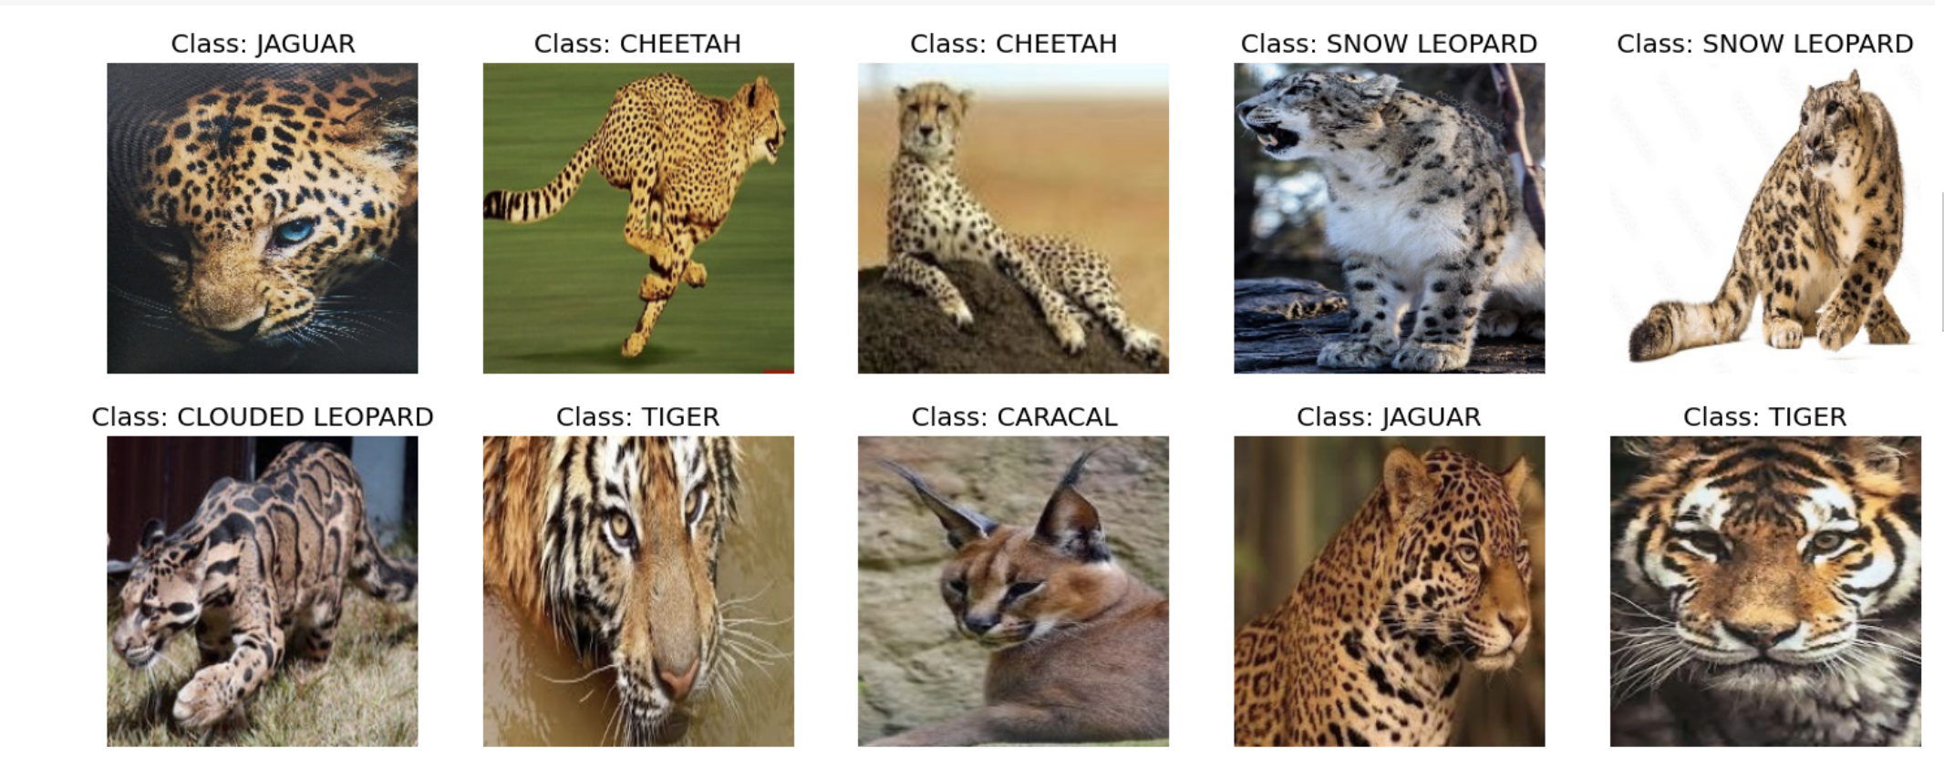
2. Dataset Details
10 classes 2339 train, 50 test, 50 validation files 224X224X3 jpg format
Images were gathered from Google searches by Kaggle author
Image Blur Quality Check to reduce redundancy

Slide 5
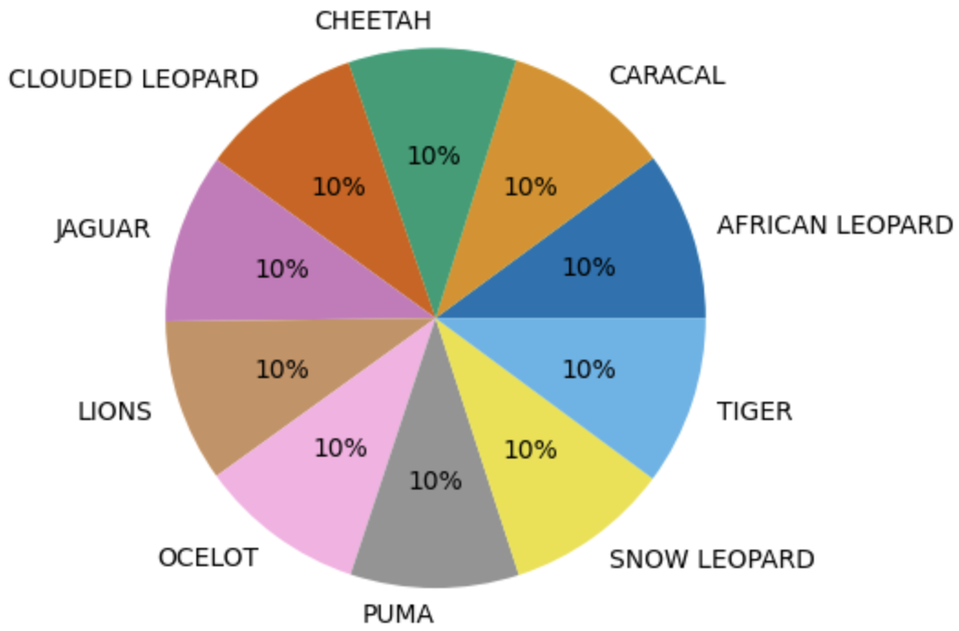
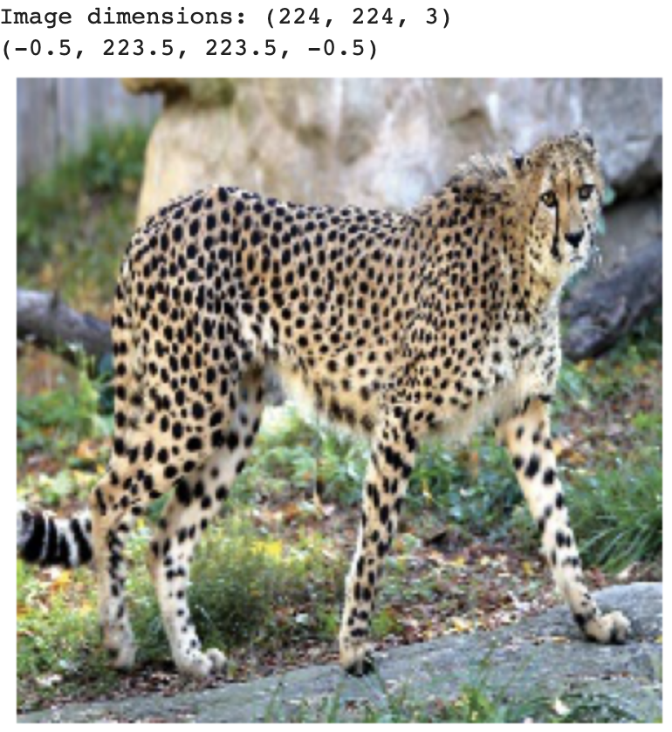
3. EDA (Exploratory Data Analysis) Outcomes
For each of train, test & valid datasets, instances were consistent hence no outlier data.
Pie charts depict balanced dataset with each of the 10 classes accounting for approximately 10% of the data.
Image Dimensions checked
Notes:
Checked for potential class imbalance
This can be helpful in determining whether any resizing or cropping is necessary before feeding the images into a machine learning model.

Slide 6
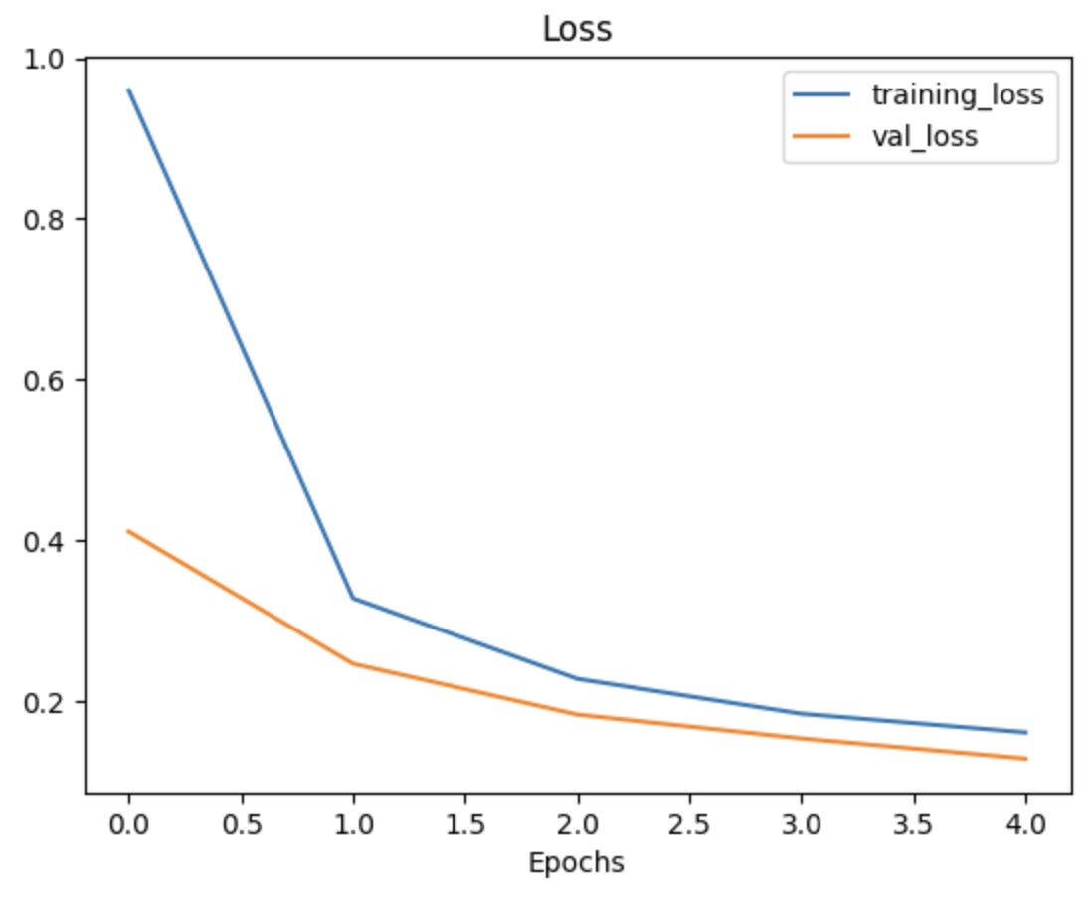
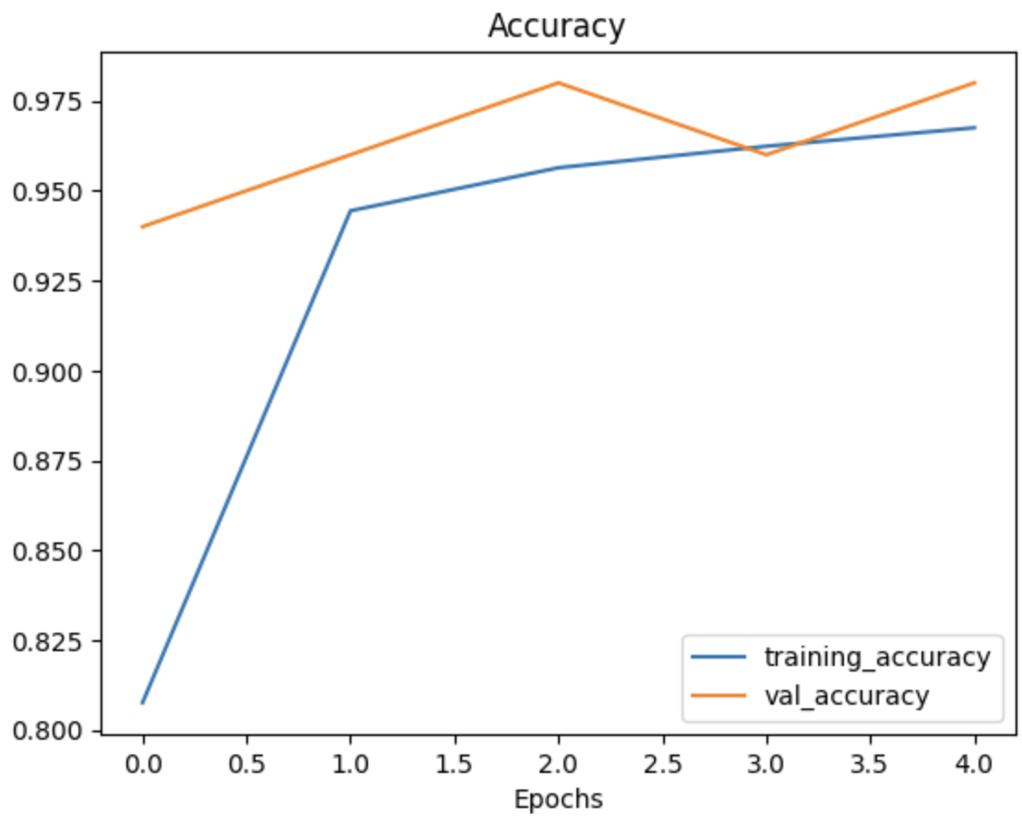
4. PDA (Predictive Data Analysis) Outcomes
The goal is to predict the classes of the images in the dataset with high accuracy.
Notes:
The loss is a measure of how well the model's predictions match the true labels in the test set, with lower values indicating better performance.
The accuracy represents the proportion of correctly classified examples in the test set, with higher values indicating better performance.
an epoch is a unit of measurement that indicates how many times the learning algorithm has passed through the entire dataset

Slide 7


5. Implementation and Deployment (TkInter/Flask/Streamlit) Plan and Status Update
Implementation and deployment plan
Current status – Web App Deployment Stage
This Photo by Unknown Author is licensed under CC BY-SA

Slide 8
References /Bibliography
G. Piosenka, "Cats in the Wild Image Classification," Kaggle, 2021. [Online]. Available: https://www.kaggle.com/datasets/gpiosenka/cats-in-the-wild-image-classification.

